Slide 1

INSTITUTE : UIE
DEPARTMENT: ALL ACADEMIC UNITS
Bachelor of Engineering (All Sections)
Subject Name and Code:
Engineering Physics 23SPH-141
Prepared by: Deepak Kumar, Asso. Prof. Physics
FIBRE OPTICS
DISCOVER . LEARN . EMPOWER

Slide 2
Course Objectives
The course is designed to make the students industry ready to contribute in the growing demand of the industry at local, national and international level.
It will make the students competent to understand basic concepts and applications of advanced engineering physics and apply its principles in their respective fields at global platform.
It will enhance the skill level of the students and shall make them preferred choice for getting employment in industry and research labs.
It will give thorough knowledge of the discipline to enable students to disseminate knowledge in pursuing excellence in academic areas.

Slide 3
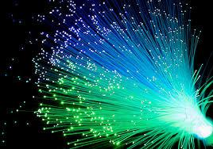
Course Outcomes
CO Number | Title On completion of this course, the students are expected to learn | Level
CO1 | Quote the basic fundamental concepts of lasers, optical fibres, crystallography, ultrasonic oscillations, semiconductor physics, quantum mechanics and nanotechnology. | Remember, Understand
CO2 | Demonstrate the working of various lasers, fibre components, semiconductor devices; explain the behaviour of crystalline solids, quantum and nano-scale systems. | Understand
CO3 | Solve problems by applying principles related to lasers, fibres, semiconductors, oscillations, quantum and nanoscience. | Applying
CO4 | Compare various lasers and fibres, semiconducting devices, crystalline materials, structures at quantum and nanoscale on the basis of their properties for industrial applications. | Analyze
CO5 | Develop various systems using lasers, fibres, semiconductors and nanomaterials for futuristic applications. | Design
Figure 2.1 Optical fibres [1]

Slide 4
Brief Flow of Presentation
Brief Introduction
Optical fiber construction
Critical angle & Total Internal Reflection
Acceptance angle & acceptance cone
Numerical Aperture
V-Number
Types of fibers
Dispersion & its types
Attenuation and Losses in Fiber
Advantages
Disadvantages
Applications
Figure 2.2 Basic structure and parts of optical fibre [2]

Slide 5
Types of Optical fibers based on modes and refractive index
Mode is the one which describes the nature of propagation of electromagnetic waves in a wave guide.
It is the allowed direction whose associated angles satisfy the conditions for total internal reflection and constructive interference.
Based on the number of modes that propagates through the optical fiber, they are classified as:

Slide 6
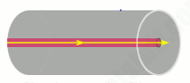
Single Mode fibers can propagate only the fundamental mode.
Multimode fibers can propagate hundreds of modes.
Single mode fibers:
In a fiber, if only one mode is transmitted through it, then it is said to be a single mode fiber.
A typical single mode fiber may have a core radius of 3 μm and a numerical aperture of 0.1 at a wavelength of 0.8 μm.
Figure 2.3 Single mode fiber [8]

Slide 7
Features of Single Mode Fiber
Only one path is available.
Core diameter is small
No dispersion
Higher band width (1000 MHz)
Used for long haul communication
Fabrication is difficult and costly

Slide 8
Disadvantages of Single Mode Fiber
Difficult to couple light in and out of the tiny core
Highly directive light source (laser) is required
Interfacing modules are more expensive

Slide 9
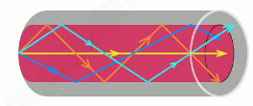
Multi mode fibers
If more than one mode is transmitted through optical fiber, then it is said to be a multimode fiber.
The larger core radius of multimode fibers make it easier to launch optical power into the fiber and facilitate the end to end connection of similar powers.
Figure 2.4 Multimode Optical Fiber [8]

Slide 10
Advantages of Multi- Mode Fiber
With a larger fiber core and good alignment tolerances
inexpensive
easy to couple light into Fiber
multimode fiber cable also provides high speed and high bandwidth over short distances.
multimode fiber cable is often used in data and audio/video applications in LANs.

Slide 11
Disadvantages of Multi-Mode Fiber
Multimode fiber cable has high dispersion and attenuation rate
The quality of optical signals is reduced as the transmission distance is getting longer.

Slide 12

Step index fiber
In a step index fiber, the refractive index changes in a step fashion, from the centre of the fiber, the core, to the outer shell, the cladding.
It is high in the core and lower in the cladding. The light in the fiber propagates by bouncing back and forth from core-cladding interface.
Figure 2.5 Single mode step index [9]

Slide 13

The step index fibers propagate both single and multimode signals within the fiber core.
The light rays propagating through it are in the form of meridinal rays which will cross the fiber core axis during every reflection at the core – cladding boundary and are propagating in a zig – zag manner.
Figure 2.6 Multimode Step index Fiber [9]

Slide 14
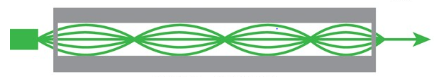
Graded index fiber
In graded index fibers, the refractive index of the core varies gradually as a function of radial distance from the fiber center.
The refractive index of the core decreases as we move away from the centre.
The refractive index of the core is made to vary in the form of parabolic manner such that the maximum refractive index is present at the centre of the core.
Figure 2.7Graded Index Fiber [9]

Slide 15
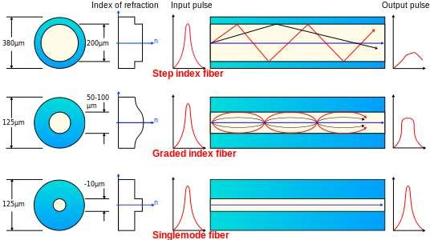
Summary of types of Fibers
Figure 2.8 Different types Of optical fibre [6]

Slide 16
Advantages of optical fiber communication
Increased Bandwidth and Channel Capacity
Low Signal Attenuation
Immune to Noise
No Crosstalk
Lower Bit Error Rates
Signal Security
Electrical Isolation
Reduced Size and Weight of Cables
Radiation Resistant and Environment Friendly
Resistant to Temperature Variations etc.

Slide 17
Disadvantages of optical fiber communication
Specialist skills needed
Cost of installation
Cost of transmission equipment from electrical to optical signals
Optical fibers can not carry electrical power

Slide 18
Applications of optical fiber communication
As fibers are very flexible, they are used in flexible digital cameras.
Fibers are used in mechanical imaging i.e. for inspection of mechanical welds in
pipes and engines of rockets, space shuttles, airplanes.
Fibers are used in medical imaging such as endoscopes and laparoscopes.
Fibers can be used under sea communication.
Fibers are used in military applications such as aircrafts, ships, tanks etc.

Slide 19
Nuclear testing applications use optical fiber phase sensors and transducers
Fibers are used in public utility organizations like railways, TV transmission etc.
Fibers are used in LAN systems of offices, industrial plants and colleges etc.
Fibers are used in telecommunication such as voice telephones, video phones, telegraph services, message services and data networks.

Slide 20
Summary
Brief Introduction
Optical fiber construction
Critical angle & Total Internal Reflection
Acceptance angle & acceptance cone
Numerical Aperture
V-Number
Types of fibers

Slide 21
Assessment Test
Quiz link for Assessment Test:-
https://docs.google.com/forms/d/e/1FAIpQLSdoaR30UPyyOY0IRVyChKPoZVB99BOTYyw61SPEVbYoxNepFQ/viewform?usp=pp_url
Home Assignment :-
Q.1 Which fiber is preferred for under sea communication?
Q.2 Differentiate SMF and MMF Fibers.

Slide 22
References
[1] https://www.ispreview.co.uk/index.php/2013/07/alcatel-lucent-breaks-record-with-31tbps-over-a-single-fibre-optic-cable.html
[2] http://constructionmanuals.tpub.com/14026/css/Fiber-Buffers-193.htm
[3] https://www.slideshare.net/ankushsaini123/6796optical-fibres
[4] https://www.slideshare.net/MadhumitaTamhane/optical-fiber-communication-part-1- optical-fiber-fundamentals
[5] (a) http://constructionmanuals.tpub.com/14026/css/Fiber-Buffers-193.htm
(b) https://computer.howstuffworks.com/fiber-optic2.htm
[6] https://www.slideshare.net/PratyushSrivastava8/optical-fiber-cable- v2?from_action=save
[7] https://www.ques10.com/p/21598/derive-the-expression-of-numerical-aperture- for-a-/
[8] https://www.explainthatstuff.com/fiberoptics.html
[9] http://fiberonda.com/single-mode-vs-multi-mode-fiber-optic-cable/
[10] https://images.app.goo.gl/LLWfgV3PjgLc9RbDA

Slide 23
Text book
Beiser A., Ghatak A, Garg S.C., Applied Physics, Edition 1st, (2013), Tata McGraw-Hill, Noida.
Laud B.B., Laser and Non -Linear Optics, Edition 1st, (1991), Wiley Eastern Ltd.
E- content
http://www.fiberopticshare.com/what-are-the-components-of-optical-fiber.html

Slide 24
THANK YOU
For Queries:-
deepak.e1972@cumail.in

